Slide 1
StreamNet：Enabling Large-scale DAG-based Nakatomo Consensus through Stream Graph Computing

Slide 2
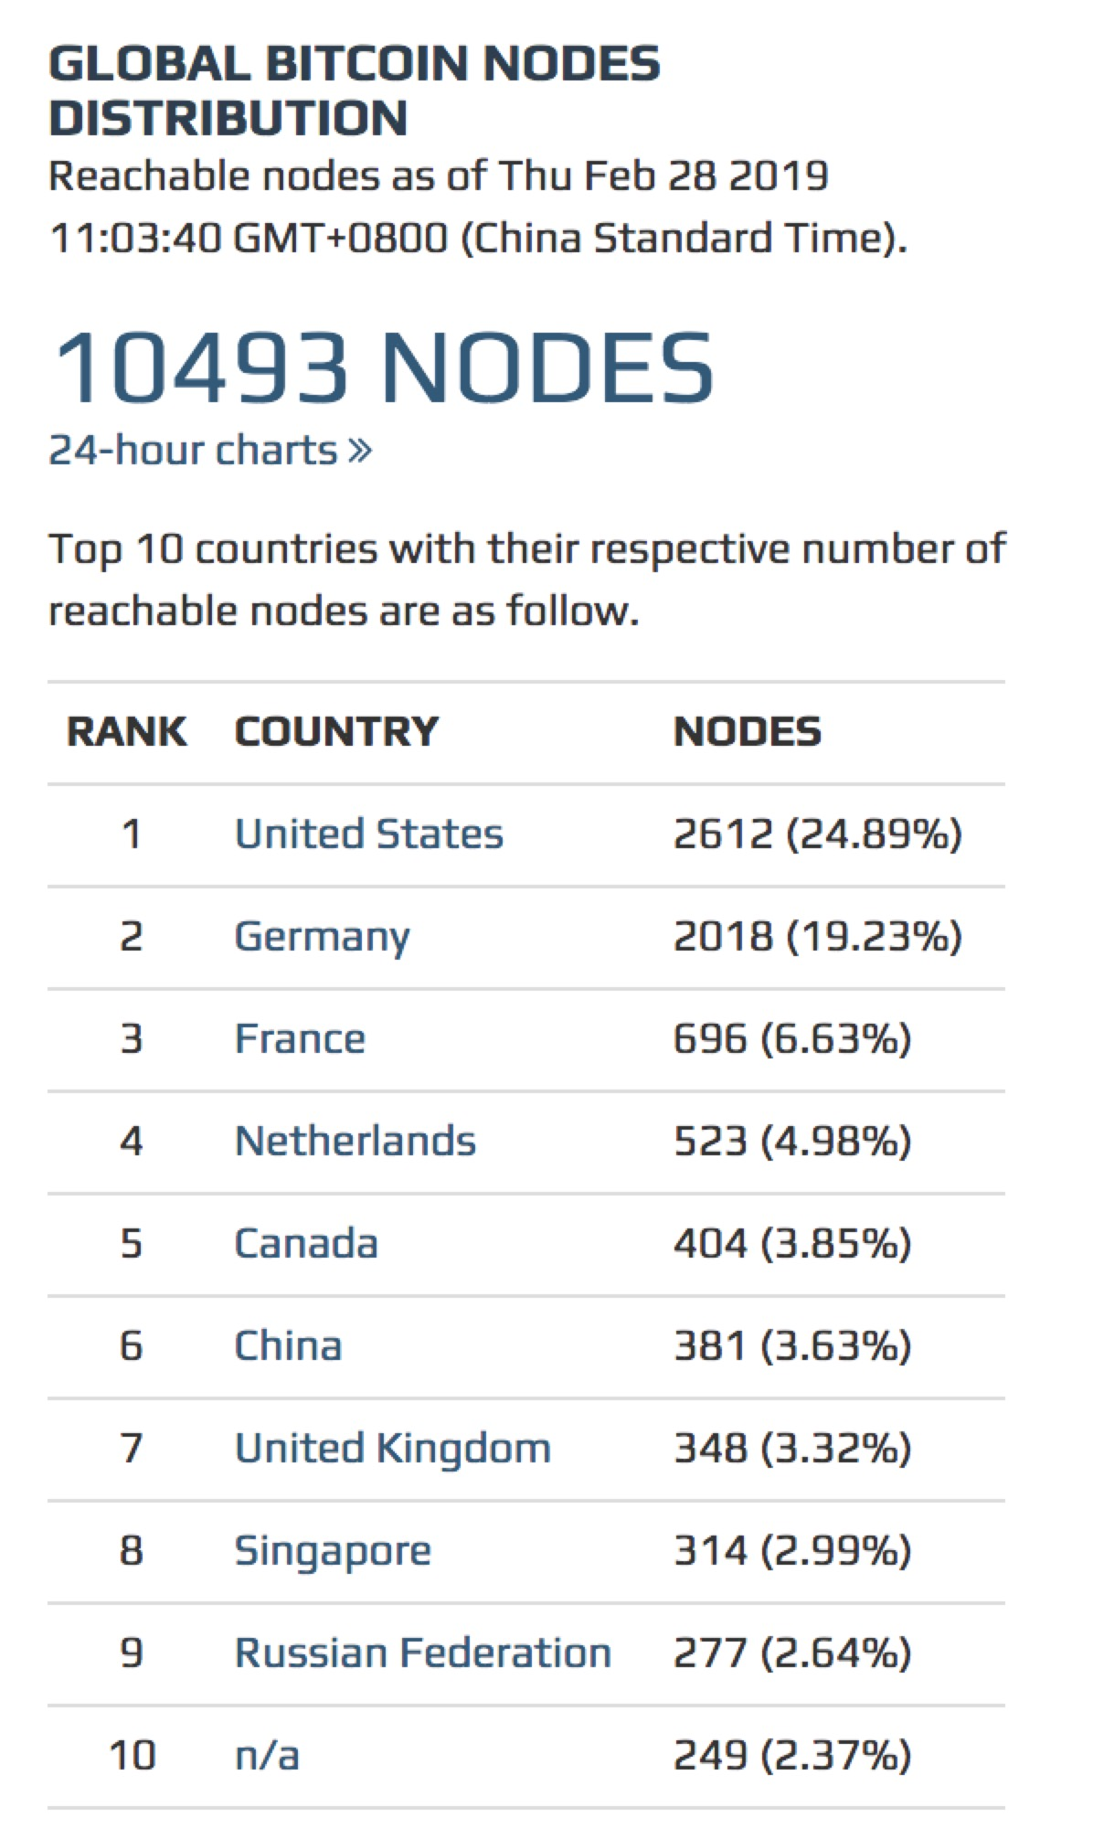

Leviatom Trust Layer – Hybrid Chain
Motivation
Traditional blockchain: slow transaction rate (about 7/sec), waste of energy.
Hybrid chain based system is one of the way to solve the problem -- super nodes ( with most computing power or most wealth) are elected and only super nodes have the privilege to commit blocks.
TRIAS Leviatom elect the most trustable nodes as super nodes.
The technologies backing this idea are:
Trusted computing (TEE) for attesting & verifying nodes;
DAG based gossip consensus protocol to propagate trust information and help make election decision.
POW/POS based chain
Hybrid chain (only green nodes can commit blocks)
Notes:
这页的1-》2-〉3-》4是否可以在如钟体现出来？

Slide 3
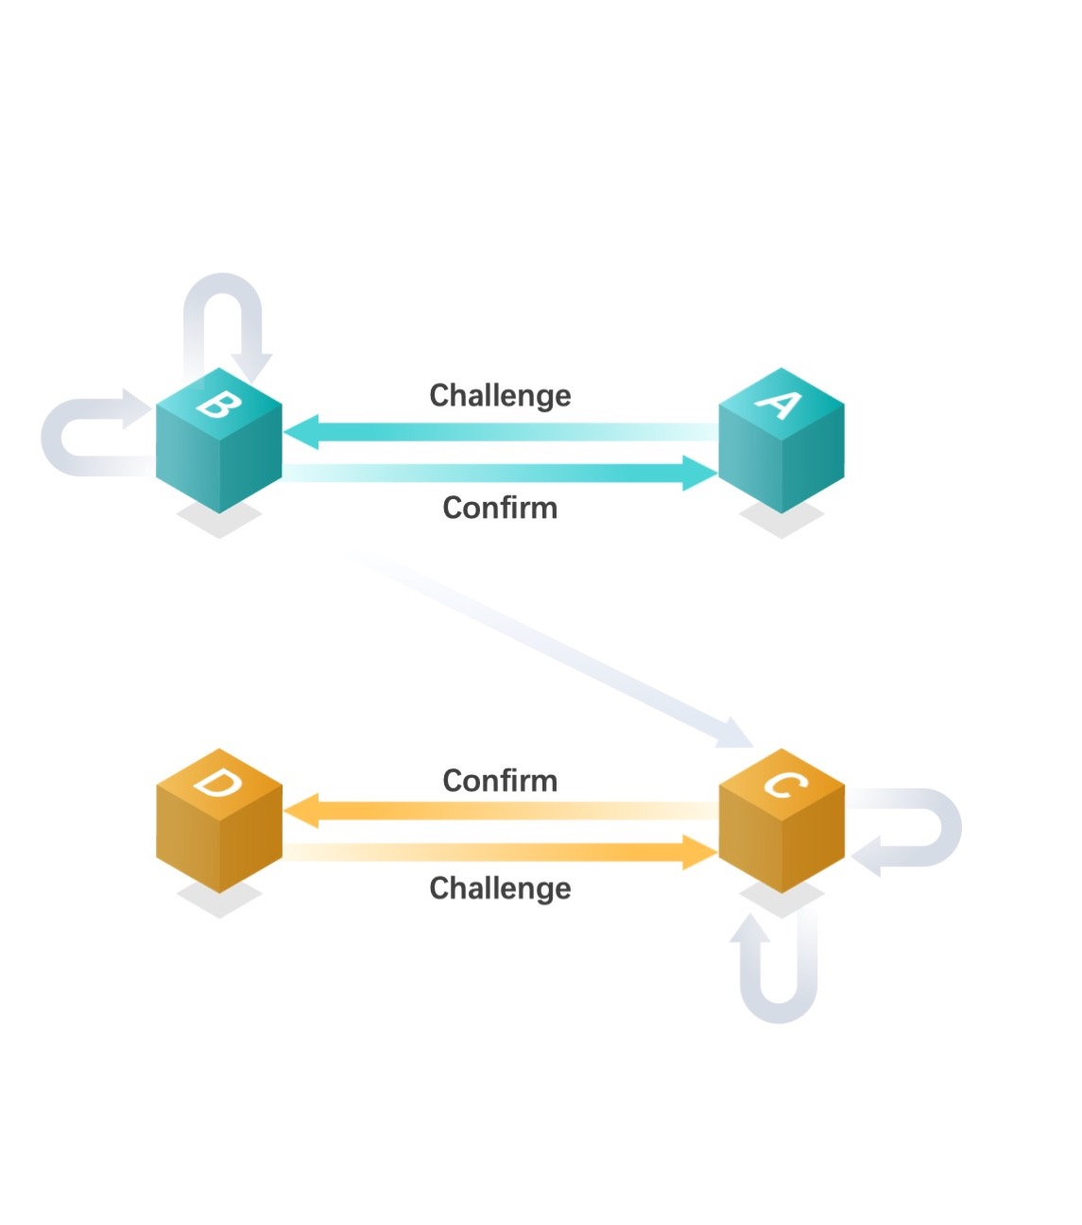
Leviatom Trust Layer - TEE/TPM Basics
Verifying a remote service' integrity with Trusted Hardware
The remote challenger first generates a random number "nonce" to challenge the trusted platform client, specifying the required PCR register number.
Making TPM client interact with TSS, load AIK, and invoking the Tspi_TPM_Quote interface to sign the specified PCR.
Signed PCR values and corresponding measurement log (ML) and AIK certificates will be fed back to the challenger.
The challenger verifies the signature of the digest data block and checks "nonce".
The challenger verifies the legitimacy of AIK certificates, whether it is issued by Trias-CA and whether it is valid within the period.
The challenger makes the next action decision based on the client state, that is, whether the PCR summary value is consistent with the expected value. The key is the process by which the user reads the measurement log (ML) to recalculate the expected value.
1
2
3
4
5
6
Notes:
这页的1-》2-〉3-》4是否可以在如钟体现出来？

Slide 4
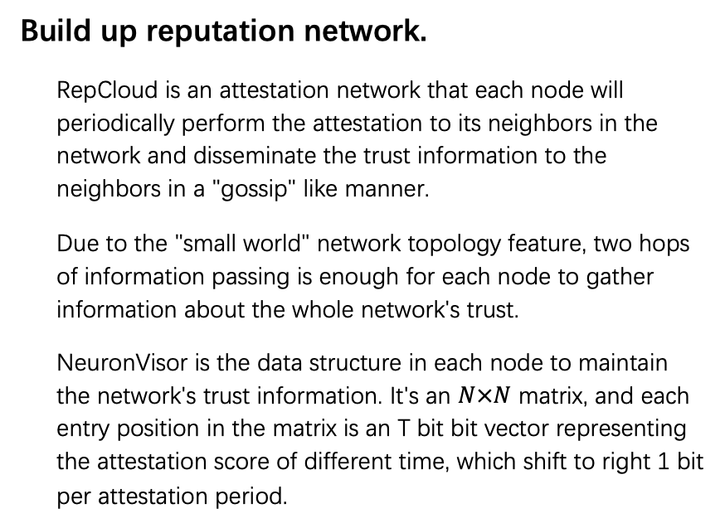
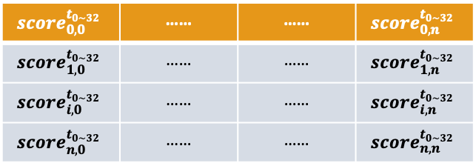
Leviatom Trust Layer – RepCloud & NeuronVisor
t_{7,4}
t_{7,8}
Build up reputation network.
RepCloud is an attestation network that each node will periodically perform the attestation to its neighbors in the network and disseminate the trust information to the neighbors in a "gossip" like manner.
Due to the "small world" network topology feature, two hops of information passing is enough for each node to gather information about the whole network's trust.
NeuronVisor is the data structure in each node to maintain the network's trust information. It's an $N×N$ matrix, and each entry position in the matrix is an T bit bit vector representing the attestation score of different time, which shift to right 1 bit per attestation period.
N_{c4}
N_{c7}
N_{c8}
t_{7,3}
N_{c6}
t_{4,3}
t_{1,7}
t_{8,1}
t_{6,1}
1
t_{3,1}
t_{5,6}
N_{b3}
N_{b1}
t_{1,5}
t_{6,5}
t_{1,3}
t_{0,3}
t_{0,1}
t_{1,2}
N_{c5}
2
t_{2,1}
t_{5,2}
N_{a0}
t_{1,0}
N_{b2}
t_{0,2}
RepCloud
3
 | …… | ……
 | …… | ……
 | …… | ……
 | …… | ……
NeuronVisor
Notes:
这页的1-》2-〉3-》4是否可以在如钟体现出来？

Slide 5
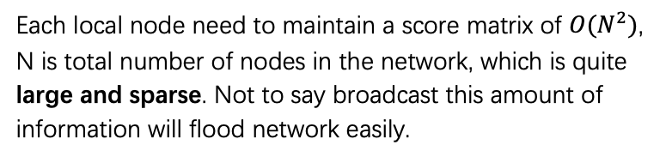
Leviatom Trust Layer – RepCloud & NeuronVisor Limitations
?
Issues to apply to the BlockChain Scenario
01
02
Assumption that there will be no network failures/partitions (CAP theorem's 'P'). And each node in the network will not cheat (Byzantine general's problem). Which is not suitable to the Blockchain domain.
There is no global consensus of time, each bit vector will shift at different time, even if there is no network issue and there is no node cheating, it's still hard to maintain a common view of scores across different nodes.
03
04
Each local node need to maintain a score matrix of $O(N^{2})$, N is total number of nodes in the network, which is quite large and sparse. Not to say broadcast this amount of information will flood network easily.
Simply calculate the total score is erroneous, and can not avoid spam.
Notes:
这页的1-》2-〉3-》4是否可以在如钟体现出来？

Slide 6
Leviatom Trust Layer – RepCloud & NeuronVisor Limitations
Suppose a lot of “cheat” nodes
(marked by red) approve node 1,
In this figure, it will have a score
Of 7, but only 2 good node 2,3 approve
4. In this case, 1 will win the super
node election.
However, in page rank algorithm,
it might not be the case.
because good node 2 will be approved
by other good nodes, and its own weight
will be larger than these bad red nodes (
which rarely receive the approval from
other good nodes)
Thus point (4) generally solved the problem
of burning computing power to inflate
votes.
Detailed explanation of PageRank:
https://en.wikipedia.org/wiki/PageRank
3
1
2
4
Notes:
这页的1-》2-〉3-》4是否可以在如钟体现出来？

Slide 7
Leviatom Trust Layer – RepCloud & NeuronVisor Limitations
01
1,2) In cloud environment, could be solved by Paxos.
1,2) In open environment while no new node join, Could be solved by PBFT.
1,2) In dynamic changing open Network, Could be solved by POW
(Nakamoto consensus)
-- but low throughput!!
Assumption that there will be no network failures/partitions (CAP theorem's 'P'). And each node in the network will not cheat (Byzantine general's problem). Which is not suitable to the Blockchain domain.
02
There is no global consensus of time, each bit vector will shift at different time, even if there is no network issue and there is no node cheating, it's still hard to maintain a common view of scores across different nodes.
StreamNet
We introduce !!
Notes:
这页的1-》2-〉3-》4是否可以在如钟体现出来？

Slide 8
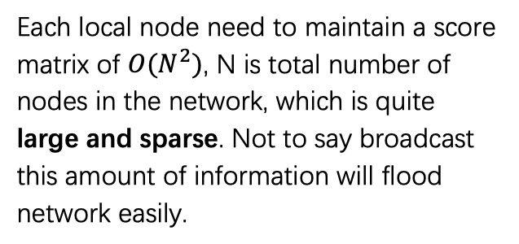
Leviatom Trust Layer – RepCloud & NeuronVisor Limitations
03
Each local node need to maintain a score matrix of $O(N^{2})$, N is total number of nodes in the network, which is quite large and sparse. Not to say broadcast this amount of information will flood network easily.
3) Data structure from adjacency matrix
To adjacency list.
04
Simply calculate the total score is erroneous, and can not avoid spam.
4) Use PageRank instead of aggregation of score.
Notes:
这页的1-》2-〉3-》4是否可以在如钟体现出来？

Slide 9
Leviatom Trust Layer - StreamNet Basics
The trust information is broadcasted through StreamNet
StreamNet is a consensus protocol that is based on Conflux [2] algorithm. And this protocol is Nakamoto consensus [1] algorithm, which is Byzantine tolerant.
It's a DAG that is maintained in a distributed environment. Every block in the DAG contains data uploaded by the user, and it will approve two previous data by calculating nonces.
Each StreamNet machine will grow its DAG locally, and will broadcast the changes using gossip protocol. Eventually, every machine will have a unified view of DAG.
By calling total ordering algorithm, every machine can sort the DAG into a total order, and the data in each block can have a relative order regardless of their local upload time.
StreamNet has a really high throughput leveraging the Streaming graph computing technology.
machine1
machine1
machine1
1
2
machine2
Gossip
machine2
Order
machine2
3
Gossip
Total
machine3
machine3
machine3
4
5
[1] S. Nakamoto, “Bitcoin: A peer-to-peer electronic cash system,” 2008.
[2] C. Li, P. Li, W. Xu, F. Long, and A. C.-c. Yao, “Scaling nakamoto consensus to thousands of transactions per second,” arXiv preprint arXiv:1805.03870, 2018.
Notes:
这页的1-》2-〉3-》4是否可以在如钟体现出来？

Slide 10
Leviatom Trust Layer - StreamNet Basics
machine1
machine2
Notes:
这页的1-》2-〉3-》4是否可以在如钟体现出来？

Slide 11
Leviatom Trust Layer - StreamNet Basics
Why we need a total order? Suppose both node 2 & 3 are attesting 1 at time 1, now they all have the score of 1 as 1000
Score: 1000
2
1
3
Score: 1000
However, at time 2, the score information for node 3 delayed due to network issues, then:
Score: 1100
2
1
3
Score: 0100
At time 3, node 3 received the time 2 score, and node 2 receive the time 3 score
Score: 1110
2
1
3
Score: 1010
The view of node 1 from 2 &3 are diverged now!
So we need a facility to perform consensus. And this
facility must have high throughput.
Notes:
这页的1-》2-〉3-》4是否可以在如钟体现出来？

Slide 12
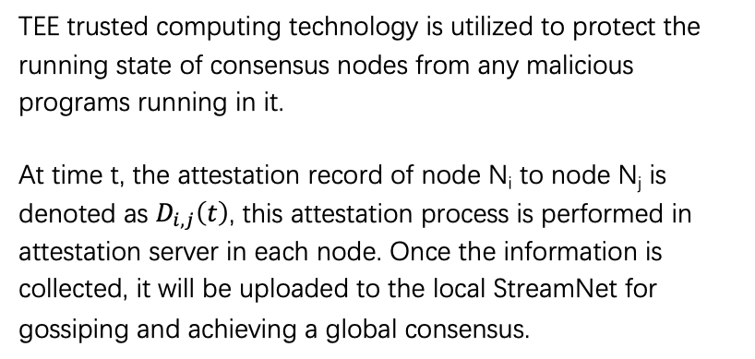
Leviatom Trust Layer – Modeling TEE Trust
A
1. Challenge
Attestation server
2. Attest
3. Sent attestation
result to APP server
APP server
TEE trusted computing technology is utilized to protect the running state of consensus nodes from any malicious programs running in it.
At time t, the attestation record of node N_{i} to node N_{j} is denoted as $D_{i,j}\left(t\right)$, this attestation process is performed in attestation server in each node. Once the information is collected, it will be uploaded to the local StreamNet for gossiping and achieving a global consensus.
4. Sent attestation
result to StreamNet
B
StreamNet
Attestation server
5. broadcast
G
APP server
StreamNet
5. broadcast
5. broadcast
F
5. broadcast
5. broadcast
5. broadcast
5. broadcast
C
D
E
Notes:
修改比较多

Slide 13
Leviatom Trust Layer – Infering nodes'ranking
Through the gossip protocol, each node will have a common view of the StreamNet DAG data, which will be calculated into a total order of data blocks.
We split this total order of blocks into different period by the size of P (for example, each period contains 100 data blocks). And for each period, using the blocks in this period will help us to construct a heterogeneous consensus graph (HCGraph). By calculating some of the graph ranking metrics (for instance PageRank). We can get a trust ranking score of every machine in the network. Which will be further utilized to elect leaders in TRIAS block chain to commit blocks in real-time.
Get total order and ranking in each period
Why not only StreamNet consensus?
The StreamNet consensus has high throughput but with high latency for confirmation.
It is not suitable for real-time consensus applications, and TRIAS consensus can do that.
…
…
…
Period 1
A
B
C
D
Period 2
F
B
C
D
Period 3
F
B
E
D

Slide 14
Leviatom Trust Layer – How to construct HCGraph?
{
Attester: a
Attestee: b
Score: 1
}
{
Attester: a
Attestee: c
Score: 0
}
{
Attester: b
Attestee: c
Score: 1
}
{
Attester: b
Attestee: a
Score: 1
}
Each block contains the attestation data telling the attestation score between machines in the TRIAS network. If we use a vertex to represent a machine, and use weighted edges to represent the score between two machines, we can construct a graph, and this graph is HCGraph.
Ranking the HCGraph is not as naïve as collecting the total scores in each vertex, because there might be lots of untrusted nodes approving each other, and trusted node's approving might be more important.
One of the well-known algorithm to solve the graph ranking problem is PageRank.
Construct HCGraph from attestation data in a period.
a
1
b
1
0
1
c

Slide 15
Leviatom Trust Layer – Incentives, why keep attesting?
In StreamNet, we offer NetCoin
The approaches to earn NetCoin:
Explore blocks and packing information will get NetCoin.
Upload important information will get NetCoin, such as attestation data.
The way to spend NetCoin:
Upload normal information will charge NetCoin, and the amount is dependent on the size of data.
NetCoin

Slide 16
Demo
Attest / GetRank
prod1
prod2
prod3
prod4
TEE
TEE
TEE
TEE
DAG
DAG
DAG
DAG

Slide 17
Working paper: StreamNet & Leviatom
Leviatom paper is being written …

Slide 18
Leviatom Trust Layer – Key Features
TEE-based protection to the consensus nodes, so that no malicious programs will run and tamper with the consensus protocols or configurations.
Up to 100,000 tps with at least the same security strength. TEE and Graph-based Super-node election model, achieving fairer, safer and more efficient consensus.
Realizing Energy-saving and Green-mining, as much less consensus nodes is required and the mining operations will enforce meaningful purpose (TEE inspections).
Raising the fault tolerant rate to ~99%, as heterogeneous TEE structure and graph computing is employed to avoid the single-point-of-failure-in-tech.

